Slide 1


ENGINEERING EXPLORATION
PROJECT TITLE
HAND GESTURE BOT [WITH VOICE CONTROL]
STUDENT NAME | FACULTY / MENTOR
VARUN.A-21EC111
YASVANT.R-21EC115
SUJITH.R-21EC102
VETRIVEL.K-21EC113
Mrs.
REMYA / ECE

Slide 2
CONTENTS
INTRODUCTION
WORKING PRINCPLE
BLOCK DIAGRAM
COMPONENTS REQUIRED
CIRCUIT DIAGRAM
CONSTRUCTION
APPLICATION
ADVANTAGES
DISADVANTAGES
CONCLUSION

Slide 3
INTRODUCTION
Robots are playing an essential role in automation across all sectors like construction, military, medical, manufacturing, etc. After making some basic robots like a line follower robot, a computer-controlled robot, etc., we have developed this accelerometer-based gesture-controlled robot with an Arduino Uno. We have used hand gesture motion to drive the robot using an accelerometer. A gesture-controlled robot is controlled by using the hand in place of any other method like buttons or joystick. Here one only needs to move the hand to operate the robot. A transmitting device is placed in the user's hand, which contains the RF Transmitter and accelerometer to transmit a command to the robot so that it can perform the required task of moving forward, back, turning left, right and stop. These tasks will be identified using the hand gesture.

Slide 4
WORKING PRINCIPLE
Our gesture-controlled robot works based on accelerometer outputs, which correspond to hand movements and sends that data to a comparator which assigns specific voltage level to the movements. This information is transferred to an encoder which encodes it before RF transmission. On the other end, the information is received wirelessly via RF. These decisions are sent to the motor driver, which triggers the motors in specific configurations to make the robot move in different directions

Slide 5
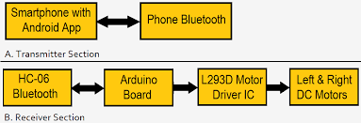
BLOCK DIAGRAM

Slide 6
COMPONENTS REQUIRED
Motor driver shield
Bluetooth module
Gear motor
Robot Wheels
Li-ion battery
Battery Holder
Arduino Uno board
Jumper Wires
Acrylic sheets

Slide 7
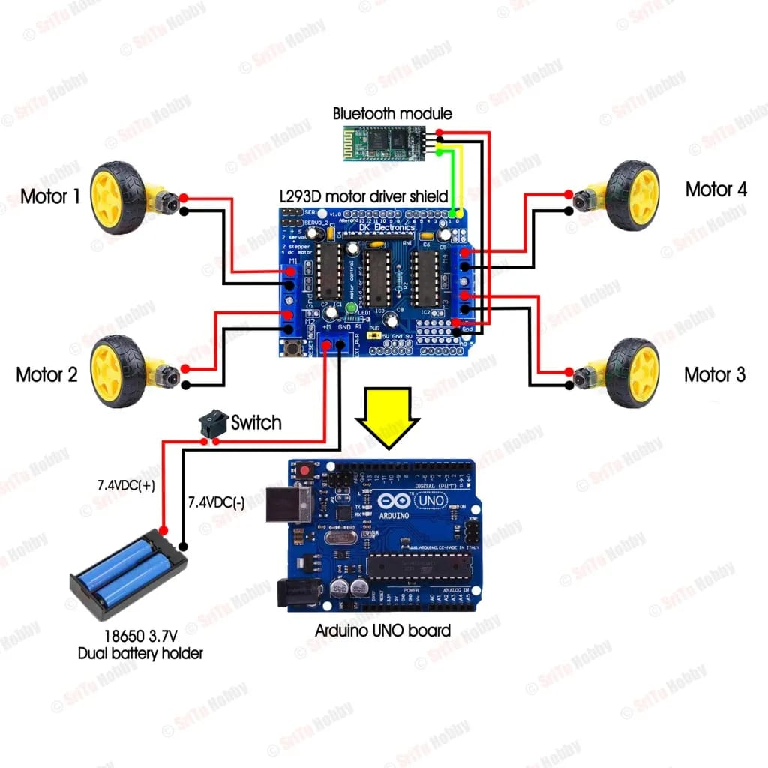
CIRCUIT DIAGRAM

Slide 8
CONSTRUCTION
Gear motors 1,2,3,4 is connected to motor driver shield
Gear motor 1 is connected to m1
Gear motor 2 is connected to m2
Gear motor 3 is connected to m3
Gear motor 4 is connected to m4.
The +vcc of Bluetooth module is connected to the 5v in Arduino.
The GND is connected to the GND of Arduino.
Tact switch is type of switch which are signal switches that require a touch to open or close the circuit .
The tact switch has two ends where one end is connected to the arduino pin of D12 and another end of the tact switch is connected to the ground GND.

Slide 9
APPLICATION
Wireless controlled robots are very useful in many applications like remote surveillence ,military etc….
Hand gesture controlled robot can be used by physically challenged in wheelchairs.
Hand gesture controlled industrial grade robotic arms can be developed.

Slide 10
ADVANTAGES
Easy to operate.
Low power consumption.
User friendly.
Single equipment =multiple application.
When extended further in the hardware section ,numerous applications can be added.
One can able to control one’s slave robot just by hand gestures by this technology.

Slide 11
DISADVANTAGES
Irrelevent object might overlap with the hand .Wrong objects extractions appeared if the objects large than hand .
Performance recognition algorithm decreases when the distance is greater than 1.5 meters between the user and the camera .
Ambient light affects the colour detection threshold.

Slide 12
CONCLUSION
Hand gesture recognition is of the great importance for human computer interaction(HCI)because of its extensive applications in the virtual reality and sign language recognition etc.

Slide 13
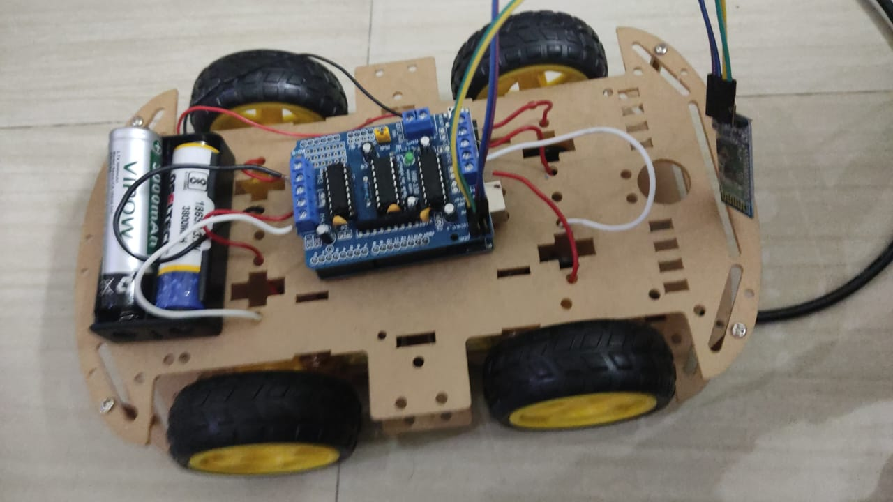
HARDWARE MODEL

